Slide 1



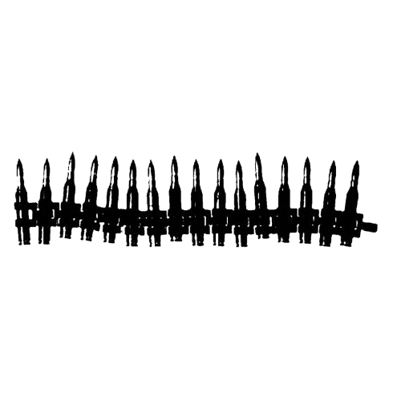
Team 1

Slide 2

Team 1
Mohamed Mahmoud Anwer
Youssef Essam Mohamed
Ziad Mostafa Farouq
Abdullah Ghareeb
Haya Hany Mokhtar
Rozana Mohamed Ahmed

Slide 3


Police Shootings Data
Data Source & Origin
Origin: Initiated in 2015 following the incompleteness of federal records on police shootings.
Mental Health: Indicators of mental illness.
Demographics: Age, Gender, Race, and Name of the deceased.
Accountability: Presence of Body Cameras.
Methodology: Aggregated from news reports, law enforcement records, and social media monitoring.
Threat Level: Was the person armed? (Gun, knife, toy weapon, unarmed).
Location: Specific City and State
Credibility: Winner of the Pulitzer Prize for Public Service. Considered the most comprehensive database of its kind.
Behavior: Was the person fleeing? Attacking?
Scope: Records every fatal shooting in the U.S. by an on-duty police officer (2015-2024).

Slide 4
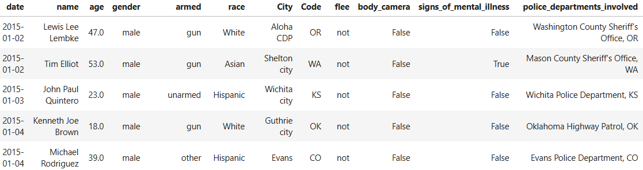
Understanding the Variables: Incident Granularity
Demographics: Age, Gender, Race, and Name of the deceased.
Mental Health: Indicators of mental illness.
Threat Level: Was the person armed? (Gun, knife, toy weapon, unarmed).
Accountability: Presence of Body Cameras.
Behavior: Was the person fleeing? Attacking?
Location: Specific City and State

Slide 5
Understanding the Variables: Incident Granularity
Demographics: Age, Gender, Race, and Name of the deceased.
Mental Health: Indicators of mental illness.
Threat Level: Was the person armed? (Gun, knife, toy weapon, unarmed).
Accountability: Presence of Body Cameras.
Behavior: Was the person fleeing? Attacking?
Location: Specific City and State

Slide 6



Dimension socioeconomics
Economic Indicators : Tracks financial stability via Median Household Income and Poverty Rates.
Social Metrics : Includes Education Levels (High School graduation rates) to assess community background.
Demographic Composition : Breaks down population diversity by race (White, Black, Hispanic, Asian, Native American).
Analytical Value : Enables the correlation of police shooting incidents with local socio-economic conditions over time (2015-2023).
composite primary key

Slide 7
Data Cleaning

Slide 8
Project Objective
Our goal is to clean and prepare two data sources: a Fact Table of 9,893 police shooting incidents and Dimension Tables with US city socioeconomic data (2015-2023). The final output is a single, merged dataset (Clean_Data.csv) ready for analysis.
Initial Fact Table Standardization
Multi-Stage City Imputation
Fuzzy Matching
Final Standardization
Schema Alignment

Slide 9
Phase 1: Preparation for Merging
Initial Fact Table Standardization
Multi-Stage City Imputation
Fuzzy Matching
Final Standardization
Schema Alignment

Slide 10
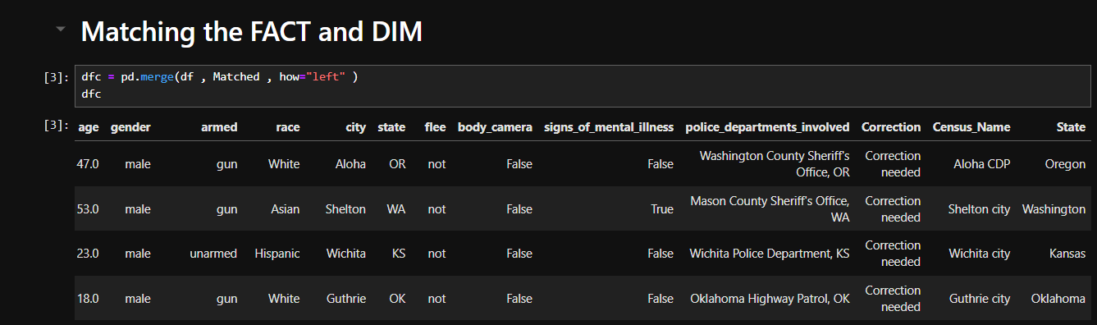
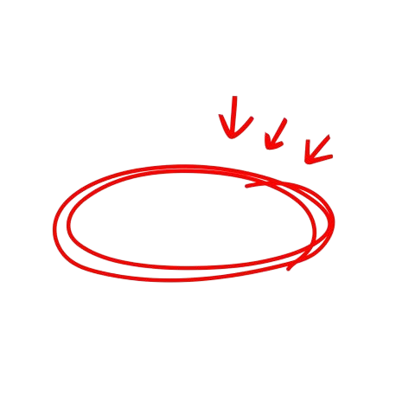
Phase 1: Preparation for Merging
Initial Fact Table Standardization
Used an external AI-pregenerated file (Matched.csv) to standardize city formats to official Census_Name equivalents.
Multi-Stage City Imputation
Fuzzy Matching
Final Standardization
Schema Alignment

Slide 11
Phase 1: Preparation for Merging
Initial Fact Table Standardization
Multi-Stage City Imputation
Fuzzy Matching
Final Standardization
Schema Alignment

Slide 12
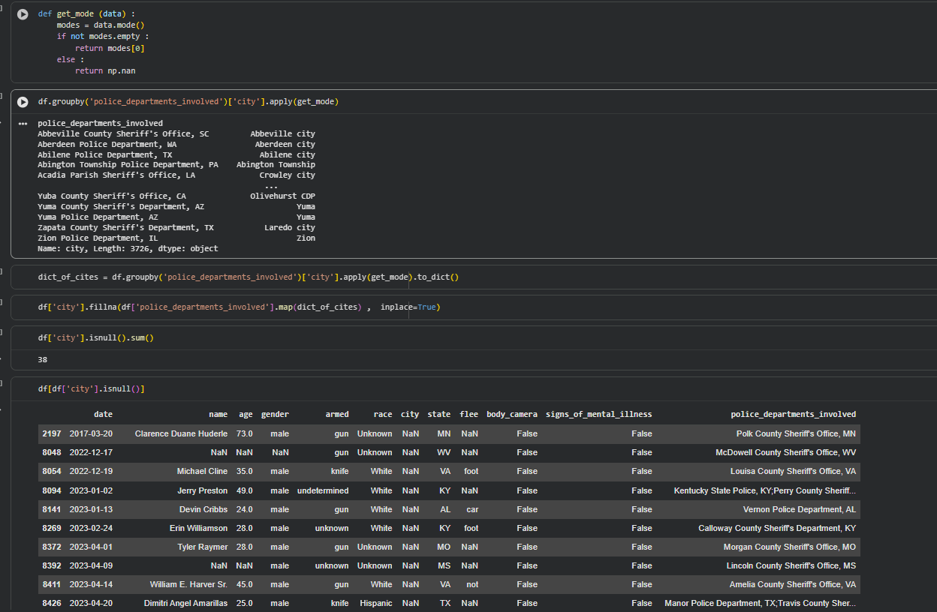
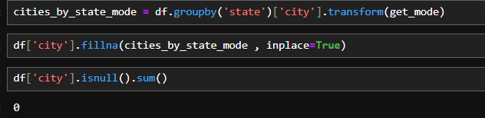
Initial Fact Table Standardization
Phase 1: Preparation for Merging
Multi-Stage City Imputation
Imputed 72 NaN city values using police department mapping (34 records) and state-to-city mode mapping (38 records).
Stage 1 : Imputed 34 Nan city values using police department mapping
Stage 2 : state-to-city mode mapping (38 records).
Fuzzy Matching
Final Standardization
Schema Alignment

Slide 13
Phase 1: Preparation for Merging
Initial Fact Table Standardization
Multi-Stage City Imputation
Fuzzy Matching
Final Standardization
Schema Alignment

Slide 14
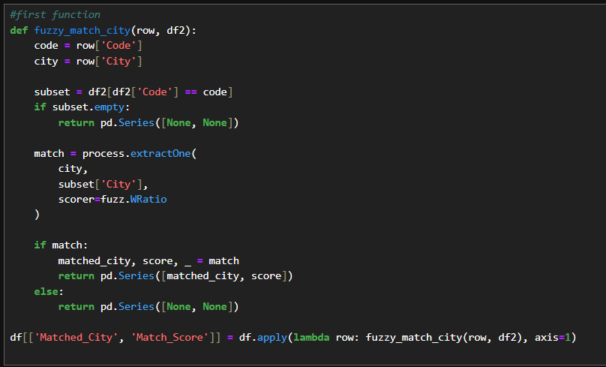
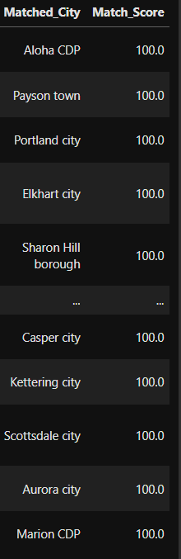

Initial Fact Table Standardization
Multi-Stage City Imputation
Phase 1: Preparation for Merging
Fuzzy Matching
Used rapidfuzz.process.extractOne to find the best city name match from the dimension table, constrained by state code for accuracy.
Final Standardization
Schema Alignment

Slide 15
Phase 1: Preparation for Merging
Initial Fact Table Standardization
Multi-Stage City Imputation
Fuzzy Matching
Final Standardization
Schema Alignment

Slide 16
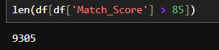
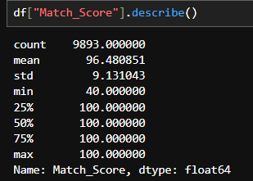
Initial Fact Table Standardization
Multi-Stage City Imputation
Fuzzy Matching
Phase 1: Preparation for Merging
Final Standardization
Overwrote the 'City' column in the fact table with 'Matched_City' to ensure identical keys.
8035 City from 9893 has match score 100%
9305 City from 9893 has match score over 85%
Average match score = 96.5%
Schema Alignment

Slide 17
Phase 1: Preparation for Merging
Initial Fact Table Standardization
Multi-Stage City Imputation
Fuzzy Matching
Final Standardization
Schema Alignment

Slide 18
Initial Fact Table Standardization
Multi-Stage City Imputation
Fuzzy Matching
Final Standardization
Phase 1: Preparation for Merging
Schema Alignment
Renamed 'city' to 'City' and 'state' to 'Code' in the fact table to match the dimension table's schema.

Slide 19
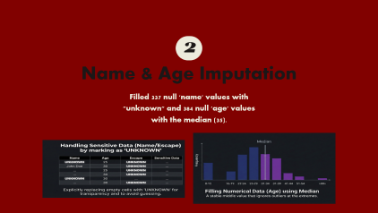
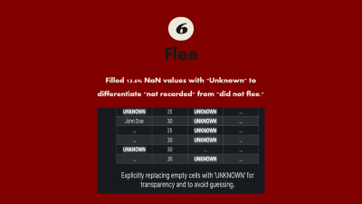
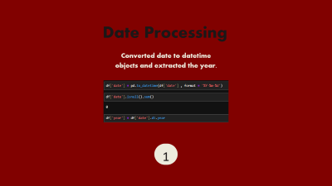

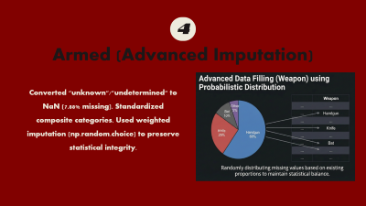
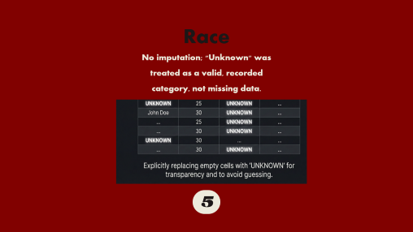
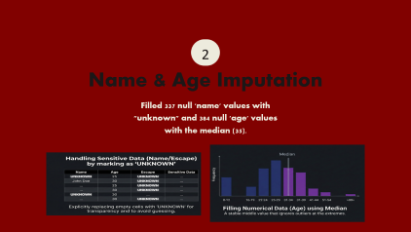
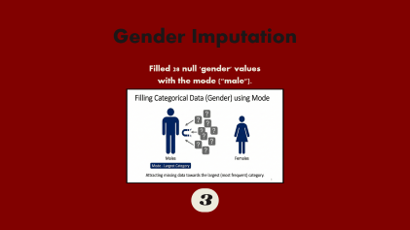
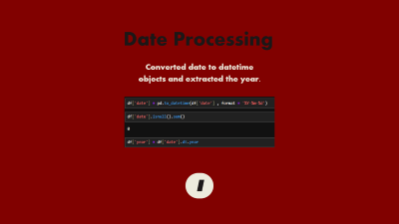

Initial Fact Table Standardization
Multi-Stage City Imputation
Fuzzy Matching
Schema Alignment
Final Standardization
Phase 2: Fact Table Cleaning
Gender Imputation
Police Departments Involved
Date Processing
Race
1
3
5
7
2
4
6
Name & Age Imputation
Armed (Advanced Imputation)
Flee

Slide 20
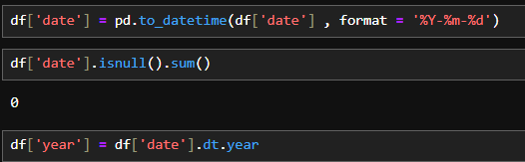
Date Processing
Converted date to datetime objects and extracted the year.
1

Slide 21
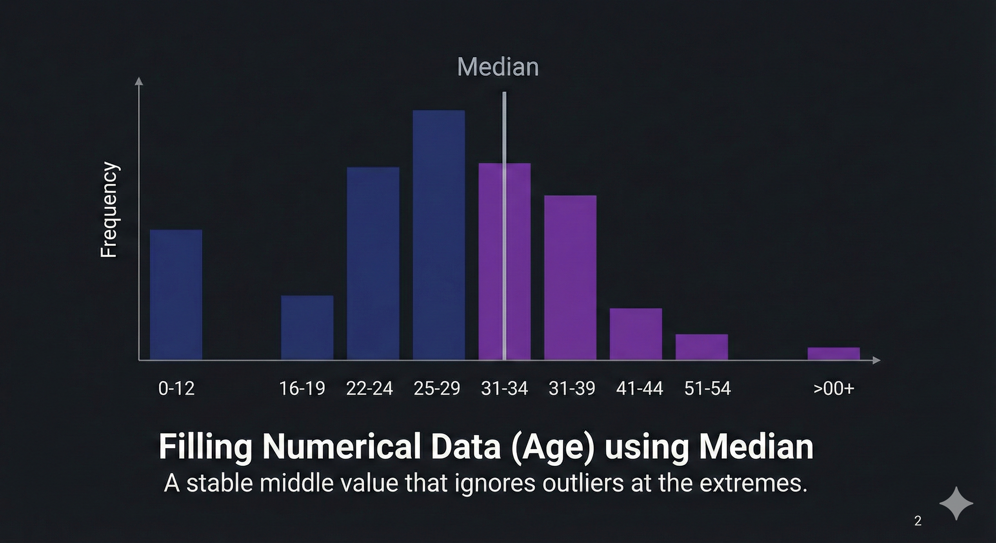
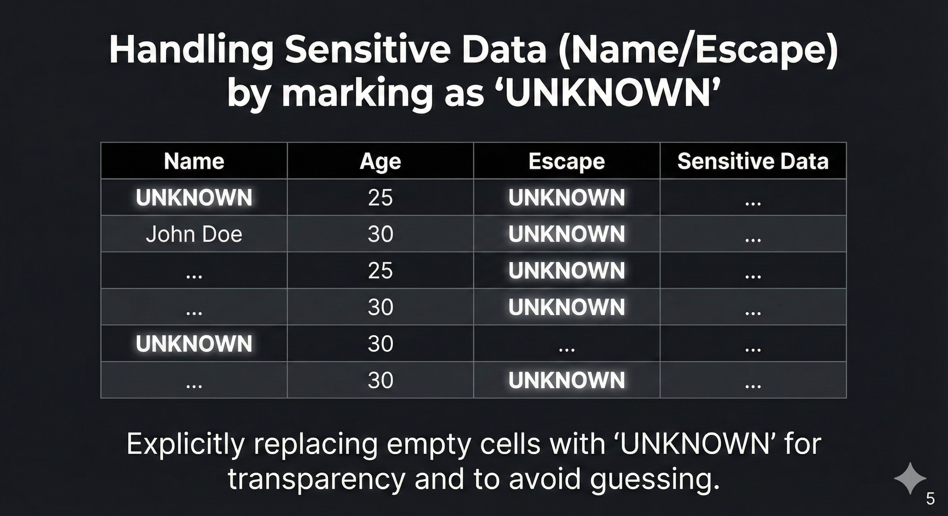
2
Name & Age Imputation
Filled 337 null 'name' values with "unknown" and 384 null 'age' values with the median (35).

Slide 22
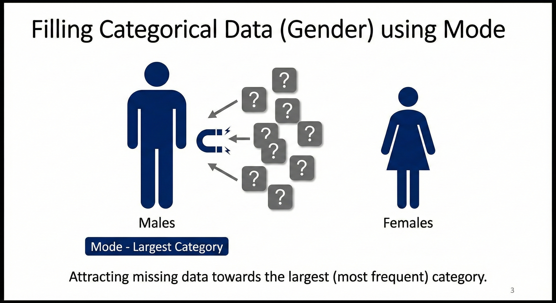
Gender Imputation
Filled 28 null 'gender' values with the mode ("male").
3

Slide 23
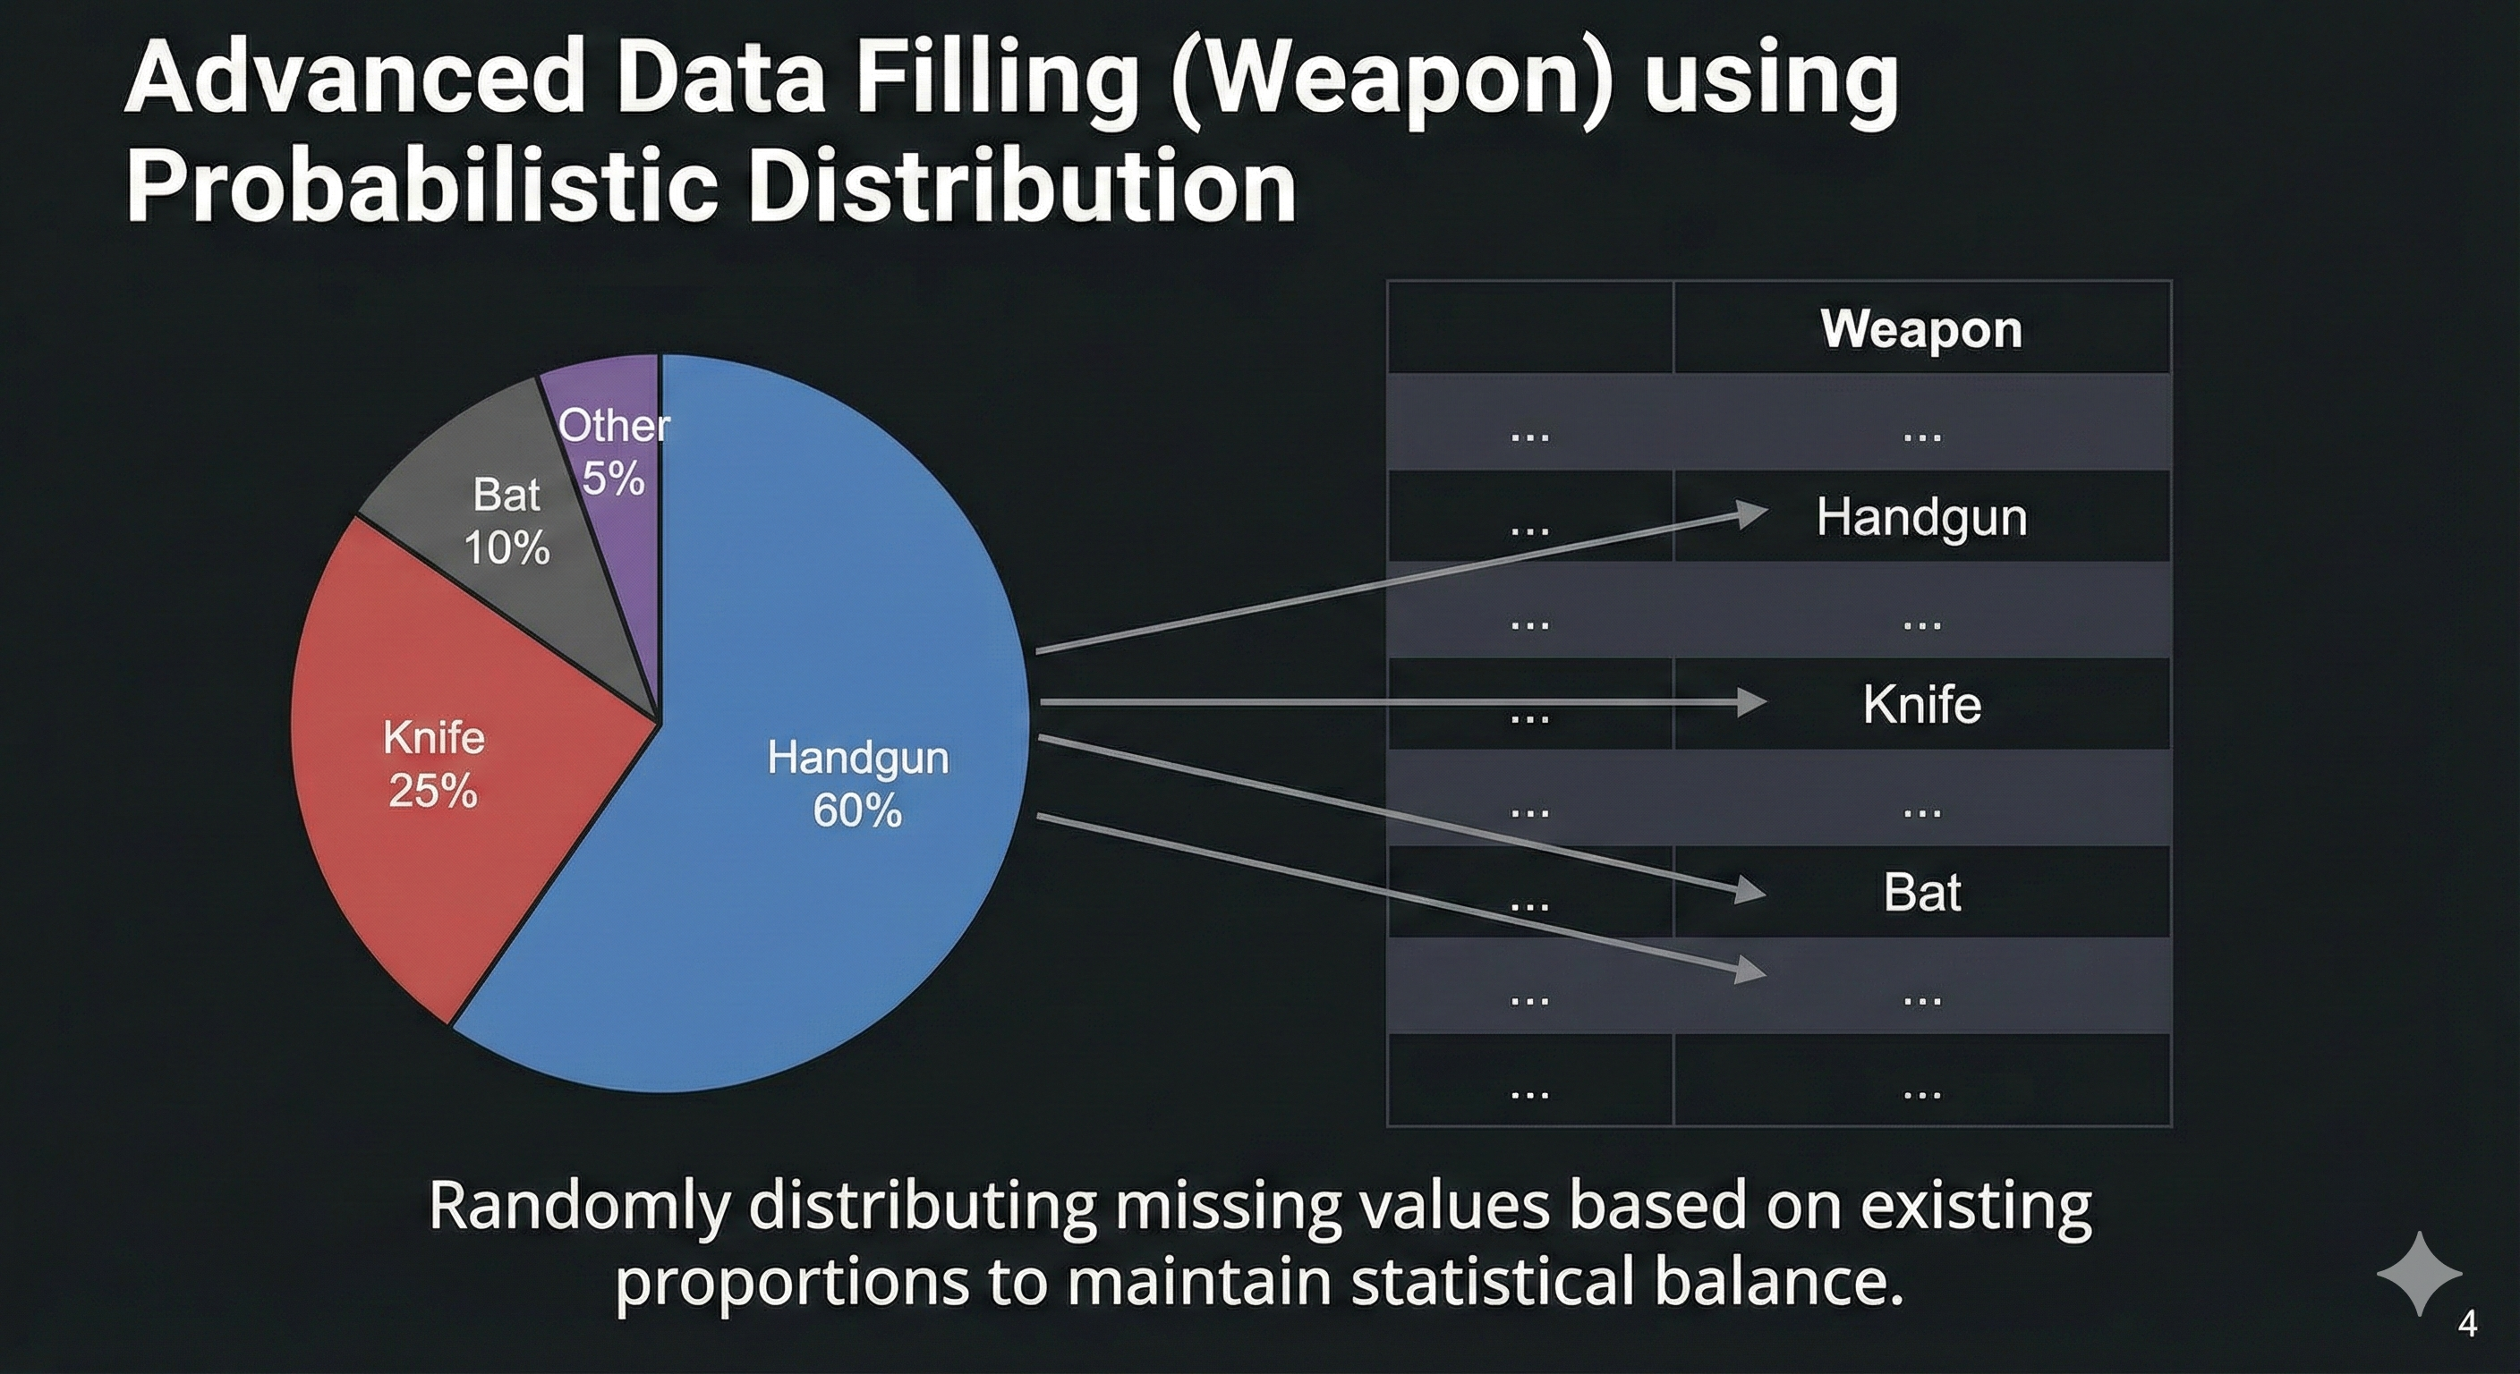
4
Armed (Advanced Imputation)
Converted "unknown"/"undetermined" to NaN (7.88% missing). Standardized composite categories. Used weighted imputation (np.random.choice) to preserve statistical integrity.

Slide 24
Race
No imputation; "Unknown" was treated as a valid, recorded category, not missing data.
5

Slide 25
6
Flee
Filled 13.6% NaN values with "Unknown" to differentiate "not recorded" from "did not flee."

Slide 26
Police Departments Involved
Manually imputed the single NaN value by referencing other records from Lewistown borough.
7

Slide 27
Phase 3: Dimension Table Cleaning
Socioeconomic Data
The merged socioeconomic table (df2) required advanced time-series imputation.
Sorting
Type Conversion
Interpolation Imputation
Validation

Slide 28
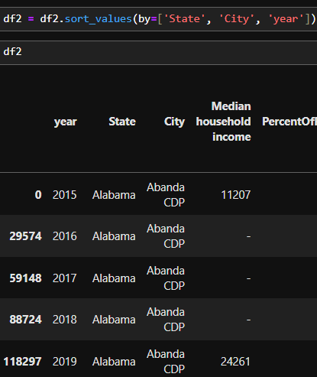
Sorting
Type Conversion
Interpolation Imputation
Validation
Data was sorted by State, City, and year for time-series-aware filling.

Slide 29
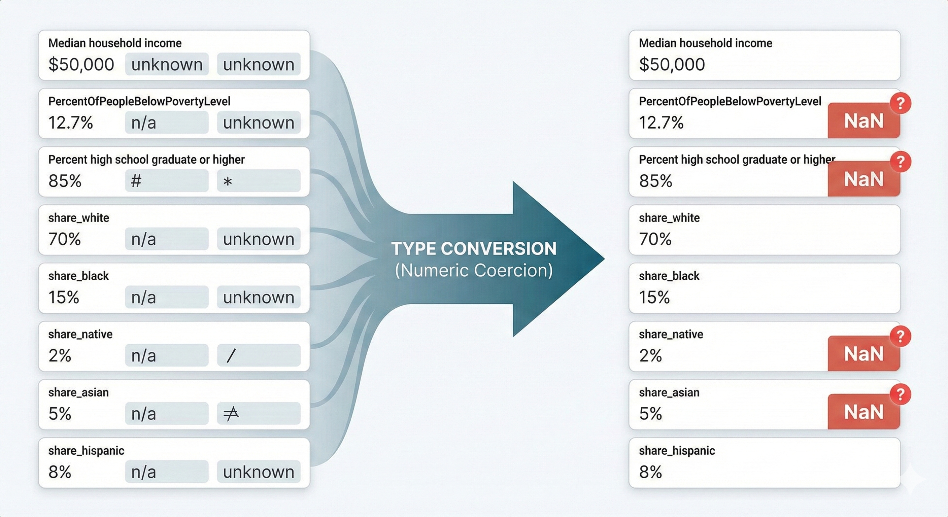
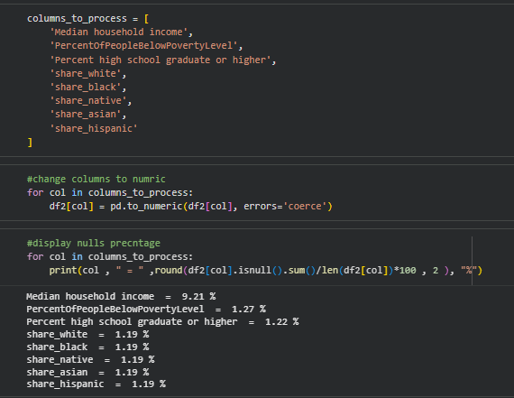
Sorting
Type Conversion
Interpolation Imputation
Validation
All socioeconomic columns converted to numeric; non-numeric values coerced to NaN.

Slide 30
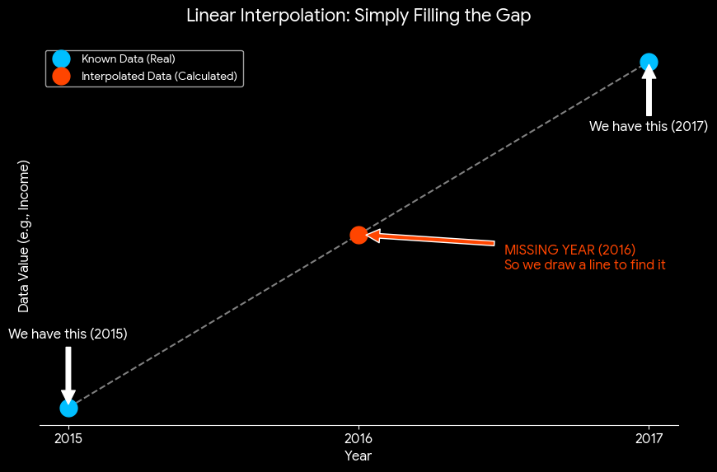
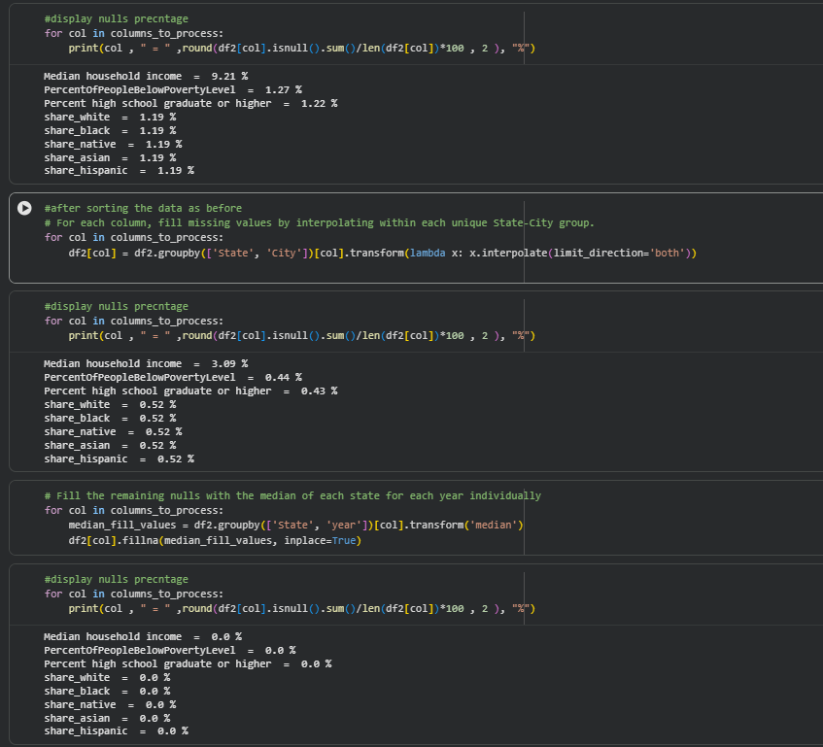
Sorting
Type Conversion
Interpolation Imputation
Validation
Interpolation filled NaNs using linear trends between years.

Slide 31
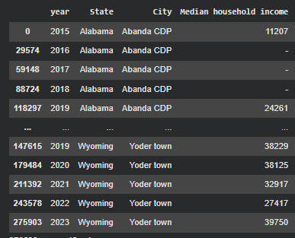
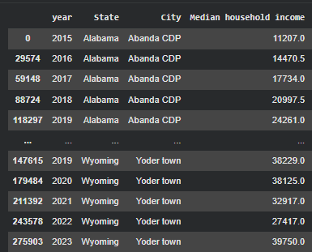
Sorting
Type Conversion
Interpolation Imputation
Validation
Interpolation filled NaNs using linear trends between years.

Slide 32
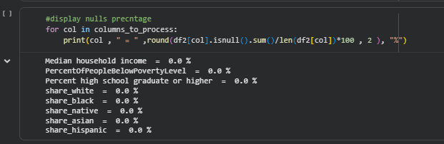
Sorting
Type Conversion
Interpolation Imputation
Validation
Confirmed zero null values and all percentage values within 0-100 range.

Slide 33
Phase 4: Final Merge and Export
The culmination of our data preparation process.
Final Merge:
A left join merged the clean fact table (df) with the clean dimension table (df2) on the composite key ['City', 'Code', 'year'] to create the final Data DataFrame.
Analysis of Merge Nulls:
A final null check showed 729 NaN values exclusively in the newly merged socioeconomic columns.

Slide 34
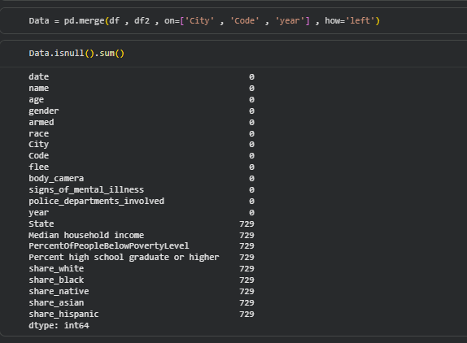

Final Merge:
A left join merged the clean fact table (df) with the clean dimension table (df2) on the composite key ['City', 'Code', 'year'] to create the final Data DataFrame.

Slide 35
Export
The final clean datasets were saved to CSV:
Clean_fact.csv
Clean_Dim.csv
Cleaned police shooting incident data.
Cleaned socioeconomic dimension data.
Clean_Data.csv
The final merged dataset for analysis.

Slide 36



Data Preparation for Analysis
Feature Engineering
Region
Age
Threat Segment

Slide 37
Feature Engineering
Defines a dictionary (region map) that groups two-letter state abbreviations (e.g., 'NY', 'IL', 'TX') into one of four US regions: 'Northeast', 'Midwest', 'South', and 'West'
Region
Age
Threat Segment
To reduce the number of unique categories (from 50+ states to 4 regions).

Slide 38
Feature Engineering
To reduce the variability of the continuous 'age' feature and capture non-linear relationships with the outcome by grouping individuals into meaningful life stages.
Region
Age
Threat Segment
converts continuous numerical Age data into discrete Age Group categories:
Minor (<18) Young Adult (18-30)
Adult (31-50) Senior (51+)

Slide 39
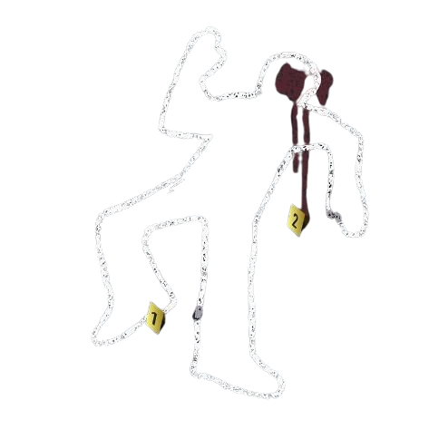

Feature Engineering
classifying each incident into a "Threat Segment" based on multiple conditions of the encounter.
transform complex, multi-variable incident details into a single, standardized, and analytically useful risk score or category.
Region
Age
Threat Segment
'7. Critical Threat (Gun Confrontation)’
'6. High Threat (Weapon Confrontation)'
'5. High Risk (Fleeing with Gun)’
'4. Medium Risk (Fleeing with Vehicle)’
'3. Special Case (Armed Mental Crisis)’
'2. Low Risk (Fleeing Unarmed/Minor)’
'1. Minimal Threat (Unarmed Static)'

Slide 40
Data Overview
Defining the scale of the problem, the locations, and the victims.
First: Is the number of incidents increasing or decreasing overtime?
Second: How are incidents distributed across regions?

Slide 41
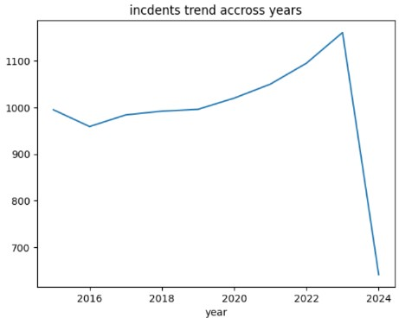
First: Is the number of incidents increasing or decreasing overtime?
2015: The count starts around 1000 incidents.
2016: There is a slight decrease, with the count dipping to its lowest point in the series (around 960 incidents).
2017-2023: Following the 2016 dip, the number of incidents shows a steady, gradual increase year-over-year. The trend line moves from approximately 980 incidents in 2017 to its peak around 1150 incidents in 2023.
Second: How are incidents distributed across regions?

Slide 42

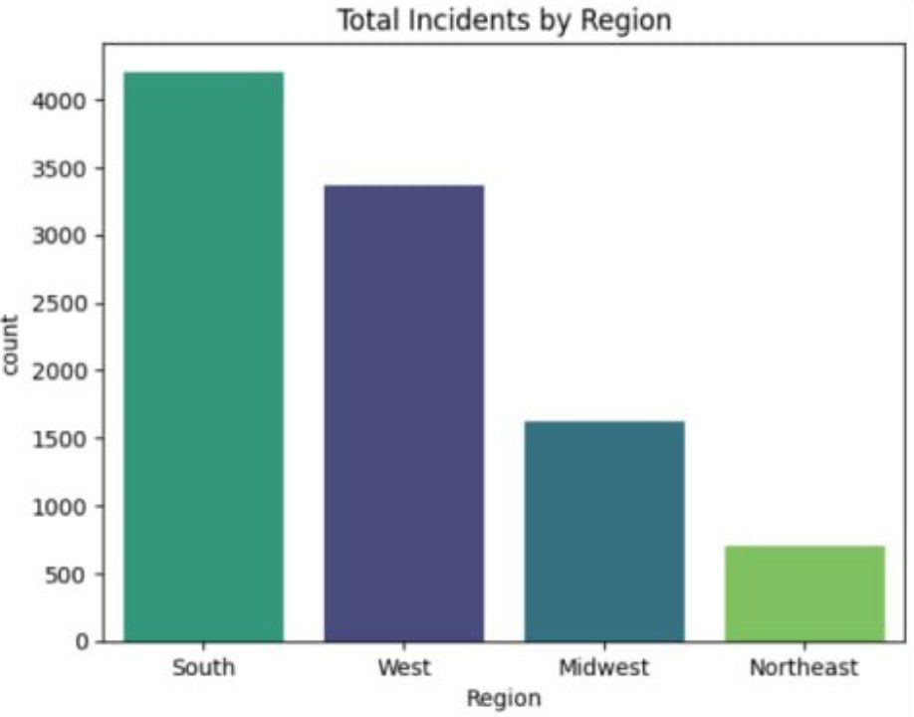

Second: How are incidents distributed across regions?
Total Incidents by Region: Highest count in the South region (over 4000), followed by the West (around 3400), Midwest (around 1600), and Northeast (under 1000).
Top 10 States: California (CA) and Texas (TX) have the highest incident counts (both over 1200).
Top 10 Cities: Los Angeles city and Phoenix city have the highest incident counts (both over 120).
First: Is the number of incidents increasing or decreasing overtime?

Slide 43
Victim Analysis
Description of the typical victim.

Slide 44
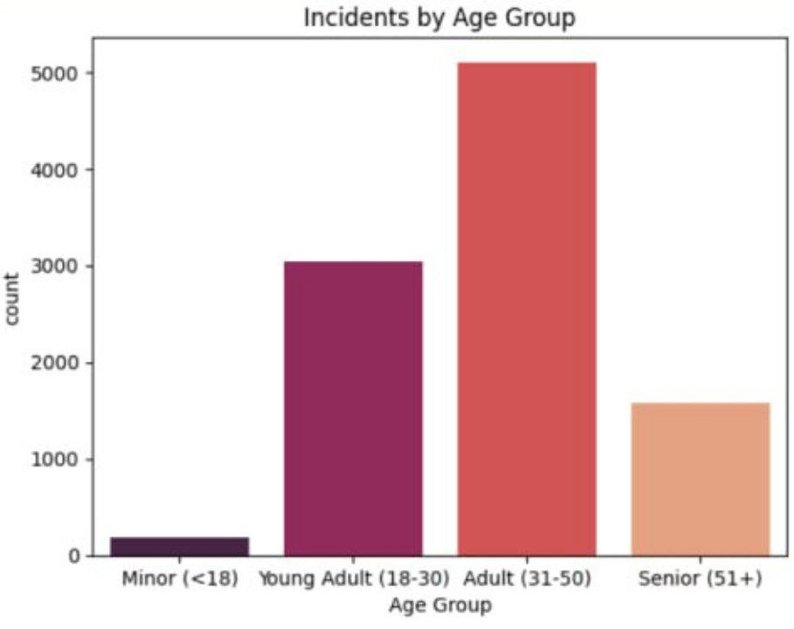
Age Distribution
The typical victim is an Adult between the ages of 31 and 50.
The Adult (31-50) group accounts for majority of the incidents, with a count of over 5,000 incidents. The next highest is the Young Adult (18-30) group, with approximately 3,000 incidents.

Slide 45
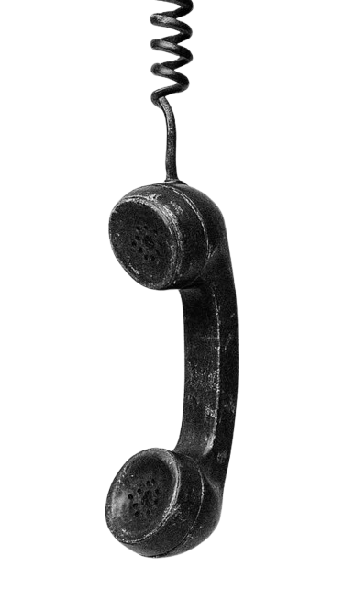
Unarmed Percentage by Race
Insight:
Black and Hispanic individuals are statistically more likely to be unarmed when involved in fatal encounters compared to White individuals.
Recommendation:
Mandate independent external investigations for all unarmed shootings to ensure transparency and trust.

Slide 46
Incident Analysis
Fleeing Suspects
Armed Status Distribution
by Mental Illness
Threat Segment
Percentage

Slide 47
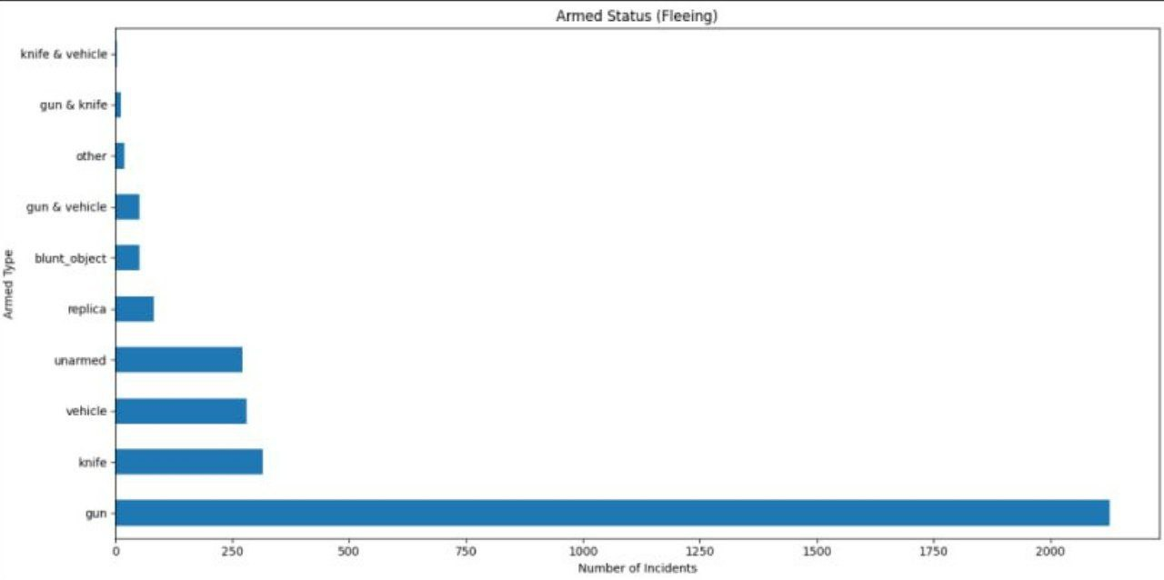
Incident Analysis
Fleeing Suspects
Armed Status Distribution
by Mental Illness
Threat Segment
Percentage
Gun is Dominant: Incidents where the victim was fleeing with a gun are by far the most frequent, with a count of approximately 2,100. This corresponds to the High Risk (Fleeing with Gun) threat segment (Segment 5).
The Knife and vehicle: Fleeing incidents involving a knife and vehicle (less than 250) which is the least.

Slide 48
Incident Analysis
Fleeing Suspects
Armed Status Distribution
by Mental Illness
Threat Segment
Percentage
Insight:
A significant number of fatalities occur while suspects are fleeing, often when they pose no immediate threat to officers or the public.
Recommendation:
Enforce a strict "No-Shoot" policy for fleeing suspects unless there is a confirmed, imminent lethal threat.

Slide 49
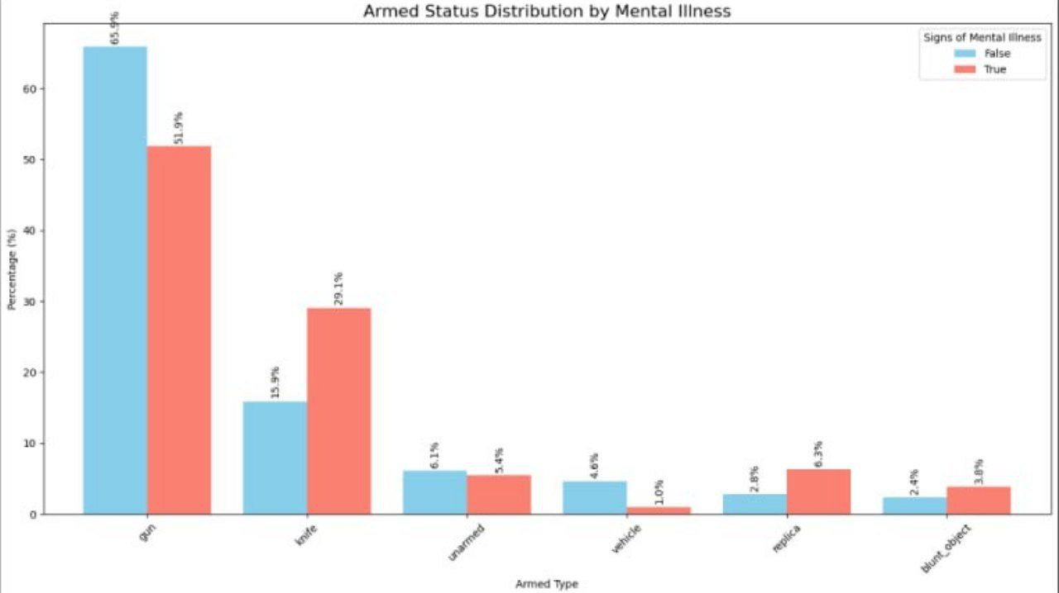
Incident Analysis
Fleeing Suspects
Armed Status Distribution
by Mental Illness
Threat Segment
Percentage
Gun Incidents:
Incidents without mental illness signs involve a gun 65.5% of the time.
Incidents with mental illness signs involve a gun 56.8% of the time.
Knife Incidents:
Incidents without mental illness signs involve a knife 17.2% of the time.
Incidents with mental illness signs involve a knife 29.1% of the time.

Slide 50
Incident Analysis
Fleeing Suspects
Armed Status Distribution
by Mental Illness
Threat Segment
Percentage
Insight:
when signs of mental illness are present, the incidents are less likely to involve a gun and significantly more likely to involve a knife or non-lethal objects.
Recommendation:
Dispatch specialized Crisis Intervention Teams (CIT) with medical professionals for mental health emergency calls.

Slide 51
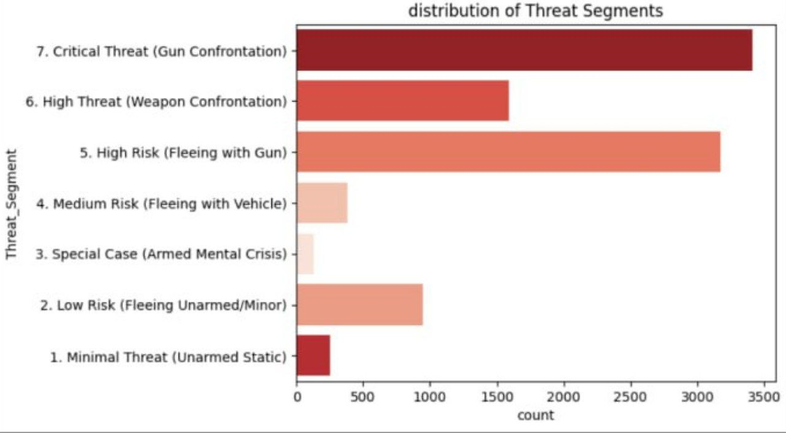
Incident Analysis
Fleeing Suspects
Armed Status Distribution
by Mental Illness
Threat Segment
Percentage
the dataset is highly concentrated in incidents involving guns, either through static confrontation or while the victim is fleeing.

Slide 52
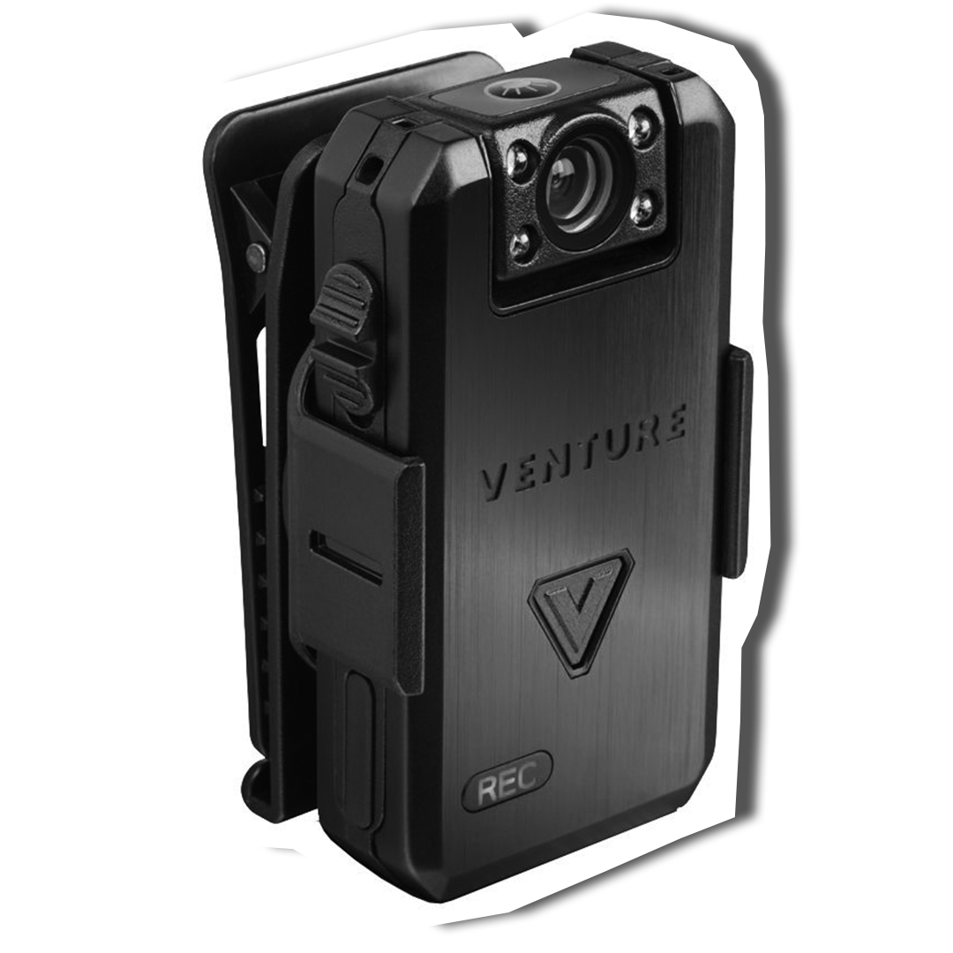

VS
Incident Analysis
Fleeing Suspects
Armed Status Distribution
by Mental Illness
Threat Segment
Percentage
Insight:
Fatal force is still recorded in "Minimal Threat" scenarios, suggesting missed opportunities for de escalation.
Recommendation:
Set a "Zero-Tolerance" goal for fatalities in low-risk segments and hold leadership accountable for these outcomes.

Slide 53
Police Analysis
VS
Bodycam Usage
Unarmed Victim

Slide 54
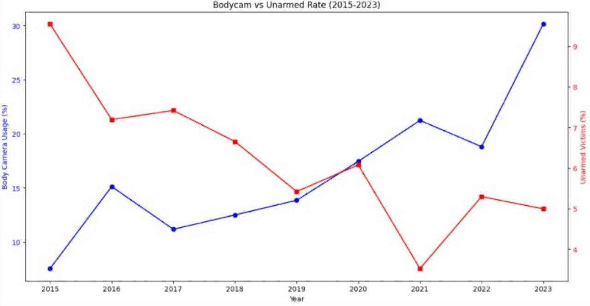
blue line up
Red line down
Bodycam Usage
Unarmed Victim
VS

Slide 55

Insight:
Data shows a negative correlation: as body camera adoption has increased over the years, the rate of unarmed shootings has decreased.
Recommendation:
Expand mandatory body camera programs to cover 100% of interactions, as they are proven to reduce high-risk outcomes.
blue line up
Red line down
Bodycam Usage
Unarmed Victim
VS

Slide 56
Prediction Model
Predicting Mental Illness in Police Encounters
blue line up
Red line down
Bodycam Usage
Unarmed Victim
VS

Slide 57
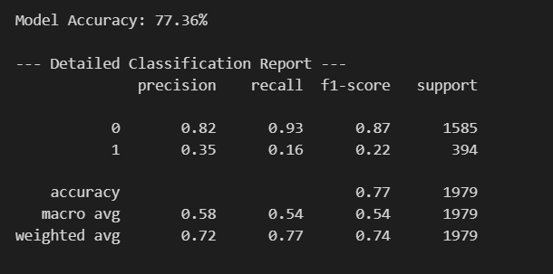
Predicting Mental Illness in Police Encounters
Goal: Build a Machine Learning model to detect signs of mental illness based on incident data (Age, Arms, Race, etc.).
The Problem (Class Imbalance):Majority: Healthy individuals (No Mental Illness).Minority: At-risk individuals (Mental Illness).
Initial Result: The baseline model was biased towards the majority, failing to detect most at-risk cases (Recall: only 16%).

Slide 58
Predicting Mental Illness in Police Encounters
Methodology: Overcoming Bias with SMOTE
Algorithm: Random Forest Classifier (Ensemble Learning).
The Fix: Applied SMOTE (Synthetic Minority Over-sampling Technique).
How it works :
Generates synthetic data points for the "Mental Illness" class.
Balances the dataset, forcing the model to learn the characteristics of at-risk individuals

Slide 59
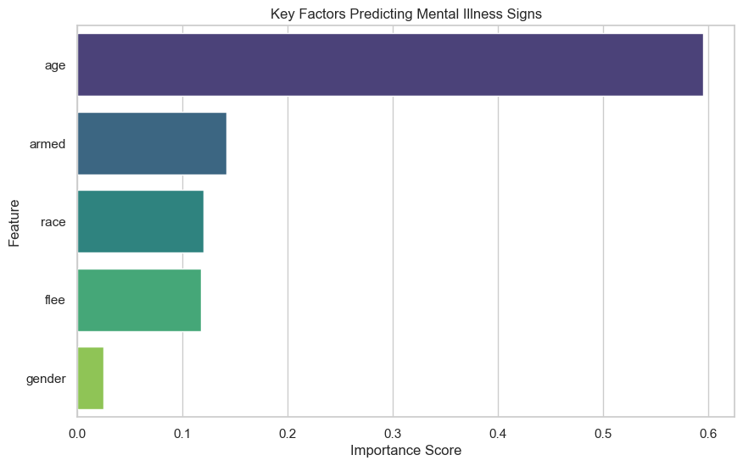
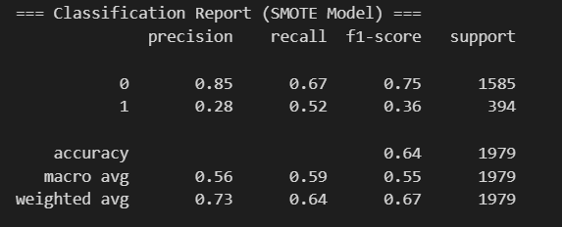
Predicting Mental Illness in Police Encounters
Results : Significant Improvement in Risk Detection
Model Comparison (Baseline vs. SMOTE)
Recall (Sensitivity): Increased from 16% ➔ 52% (3x Improvement).
Precision: Decreased to 28% (Trade-off accepted for safety).
Key Drivers: Age and Armed status were identified as the strongest predictors.
Conclusion: The optimized model is 3 times more effective at identifying potential mental health crises than the baseline

Slide 60

To the dashboard!

